Slide 1

Ansley Schug, Charles Kanoy, Jeremy Rylicki, Riley Abrahamson

Slide 2

Introduction
Team: Ansley Schug, Riley Abrahamson, Jeremy Rylicki, and Charles Kanoy
Company: Adventium Labs
Sponsor: Danielle Stewart
Stakeholder: U.S. Army
Notes:
Ansley

Slide 3

Company Overview - Adventium Labs
Based in Minneapolis, MN
Research and development in model-based system engineering
Develop solutions for safe and secure software-intensive complex systems
Partnership with various federal research and military departments
Notes:
Ansley

Slide 4
Company Overview - GUMBO Project
Overarching Project:
Grand Unified Modeling of Behavioral Operators (GUMBO)
Goal is to unify a cross-section of behavior representations in AADL to support unified behavioral analysis
Our Job:
Create a plugin for the OSATE environment that translates FACE models to AADL documents in the AGREE format.
Plugin consists of UI for system engineers to determine and set specific parameters and limitations to FACE models
Notes:
Ansley
Other things to say about GUMBO:
Verify that behaviors defined across different annexes are compatible in the modeled system
Support other modeling approaches (e.g., SysML).

Slide 5
Grand Unified Modeling of Behavioral Operators (GUMBO)
OSATE is an Eclipse-based IDE for AADL modeling
AADL is used for modeling software and hardware systems
FACE is a model to describe system architectures
AGREE is used to model assumptions and guarantees for AADL models
OSATE includes a plugin that translates FACE models to AADL
Our Job:
Create an OSATE plugin that reads an AADL instance model and translates it to an AGREE model
Create UI for system engineers to determine set specific parameters and limitations to FACE models
Notes:
Ansley

Slide 6
Need, Problem, Opportunity
FACE models do not include constraints
AGREE models require assertions
Assumptions
Guarantees
Users of GUMBO need AGREE constraints
Ease of use
Risk reduction
UI must be efficient otherwise developers won’t use it
Notes:
Chuck
Constraints are needed for complex systems
Assertions include needed constraints as assertions
An easy to use UI that automatically generates AGREE constraints improves performance of complex systems

Slide 7
Solution
Generating assertions
Requirements:
User interface constraint generation
AADL file iteration
Simple interface
Three pages
Easy add and delete design
Notes:
Chuck

Slide 8
Solution
UI Constraint Generation
Automatic presentation of variables for constraints
Assumption, guarantee, and output pages
Error reduction through finite options
Storage of previous assertions
AADL File Iteration
Access data of selected AADL file
Gather information about components
Store information in an object
Notes:
Chuck
UI Constraint Generation
Information taken from back end will be used to present variables for constraint generation
Assumption and guarantee pages will be similar and output page will be used for putting AGREE model into the AADL file
Listing variables rather than having a user fill them in reduces variability of user input, thus reducing likelihood of error
Previously generated assertions will be stored in a JSON file for future reference if necessary
AADL File Iteration
Selected AADL files hold a lot of information in an object that can help with assertion generation ready to be parsed
Components meaning components, subcomponents, features (inputs and outputs), ports, and previous annexes
Translating the AADL file object data into something that is easier for us to work with is helpful

Slide 9
Meeting Schedule
Aside from class time:
Tuesdays at 12:45pm: Team meeting
Go over current contribution of each member and next steps
Thursdays at 12:45pm: Team meeting with sponsor
Go over examples and present our current team progress to our sponsor, asking questions as needed
Any other communication occurs through Slack as needed
Notes:
-Jeremy

Slide 10
Sprint Schedule
Sprint 1:
Install OSATE environment with AADL, FACE, and AGREE support plug-ins
Develop a web prototype of the plug-in for demonstration purposes
Sprint 2:
Develop an initial version of the plug-in with full constraint adding functionality
Test for accuracy of the ports, connections, systems, and features
Simplify the UI
Sprint 3:
Constrain user input to reduce syntax errors
Polish UI field - instructions are clear
Sprint 4:
Improve time efficiency of the algorithm.
Packaging the plugin
Create documentation to assist future users
In-progress
Notes:
-Jeremy

Slide 11
Progress Status
Frontend
Polishing UI
Connecting to backend
Backend
Finishing the iteration process
Connecting to frontend
Storage
Research and early development
Packaging and Finalization
Research and early development
Notes:
Riley

Slide 12
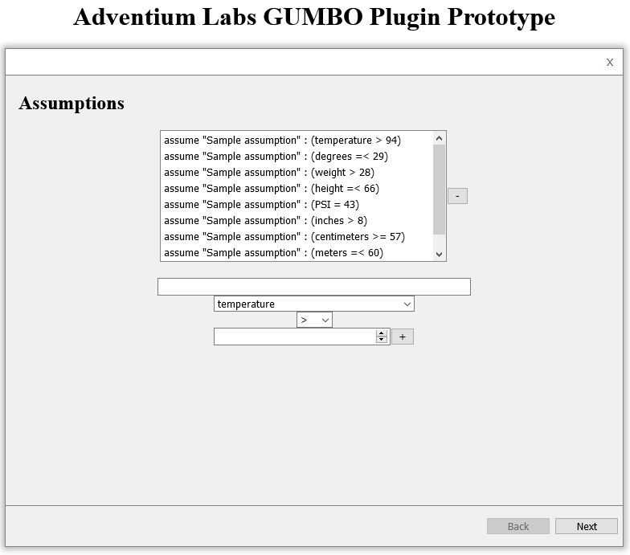
UI Prototype
A UI Prototype was built prior to plugin coding
It was developed as a web app
Created with React
Hosted on Netlify
Went through two rounds of revision with Adventium system engineers
Live link is available at: https://adventium-gumbo-ui-prototype.netlify.app/
Notes:
Riley

Slide 13

Eclipse UI Demo
Demo in Eclipse
Notes:
Riley

Slide 14
Issues/Risks
Eclipse environments breaking initially
Breaking down the project
User Interface
File Iteration
Storage
Packaging and Finalization
Creating a visually pleasing UI within the Swing framework
Notes:
Riley

Slide 15
User Story Point Analysis
F1 | As a team member I want to install OSATE environment | 3
F2 | As a team member, develop a UI prototype | 3
F3 | As a system engineer, I want to put specifications and constraints on component inputs and outputs, so that the FACE model that has been translated to AADL can be properly extended with AGREE contracts. | 3
F4 | As a project manager, I need translated AGREE contracts to be accurate with all ports, connections, features, and systems from the FACE model accounted for in the AADL model. | 2
F5 | As a project manager, I would like the user interface to be simple and intuitive, so that the rest of the team can use it efficiently. | 2
F6 | As a project manager, I would like the user interface to constrain user input so that it allows for easier translation to an AGREE model and reduces syntax errors. | 2
F7 | As a project manager, I would like the finished product to create and show a syntax error free AGREE model that can extend the AADL model. | 2
F8 | As a project manager, I want the interface to be easily understood and well organized, so that the new users and the stakeholders can pick up on how to use the project quickly. | 1
F9 | As a project manager, I want the interface to both be functional and good looking so that the stakeholders can be satisfied with the outcome of the project. | 1
F10 | As a system engineer, I want the process of generating AGREE contracts to occur within a reasonable amount of time. | 1
F11 | As a system engineer, I want to view documentation of how to install and use the plug-in. | 3
Notes:
Ansley
List user stories and point value analysis

Slide 16
Reflection
Areas of Improvement
Slow Start
Maintaining a consistent pace
Areas of Satisfaction
Unanimous satisfaction with progress
Work well as a team
Great communication between teammates and sponsor
Notes:
-Jeremy

Slide 17
Next Steps
Create a JSON file or a similar file
Will hold created assumptions and guarantees
Connect the Frontend to the Backend
Polish UI instructions and make UI appealing
Improve time efficiency
Testing the plugin
Package the plugin
Create documentation for users
Notes:
-Jeremy

Slide 18
Questions?
Notes:
- What challenges have you experienced so far? Ansley?
Setting up OSATE environment, learning OSATE environment, learning AADL, AGREE, and FACE
- What challenges do you foresee?
- Finding someone outside of our team who is willing to work with the project
- Realizing stretch goals
- Will you take me through / describe a user story?
As a system engineer, I want to put specifications and constraints on component inputs and outputs, so that the FACE model that has been
translated to AADL can be properly extended with AGREE contracts. - and explain
- How will you know that the annex provided has valid syntax?
- Currently, the UI greatly constrains what the user can put in for values to create an annex statement. This includes limiting the parameters, the comparator symbols, and even the values that the user can put in for comparison. These constraints ensure that statements should be valid AGREE.
- What have you learned in this process?
- Critical systems and how they’re programmed
- How an Eclipse plug in is developed
- Developing tooling rather than an independent application
- Do you plan testing the user interface on someone to get feedback on
the presentation and understandability of the interface?
Yes, we would like to put the tool in the hands of system engineerings to get feedback and how the “feel” of the plugin works. Then we can follow-up with any usability changes that would be helpful

